Slide 1
Decision tree
Entropy

Slide 2

Entropy
p=no. of examples of values as goal value as yes
n=no. of examples of values as goal value as no
So H(Goal)=B(6/(6+6))
=B(0.5)
=1

Slide 3


Slide 4
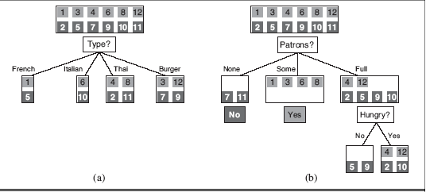


Slide 5
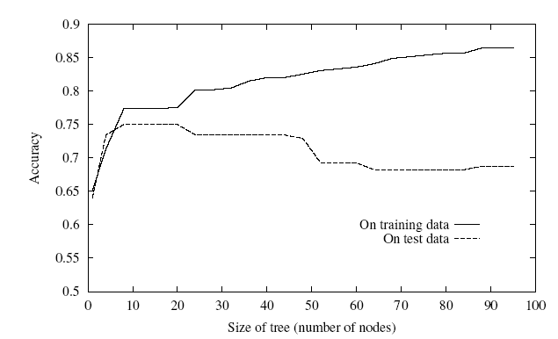
Overfitting
One of the biggest problems with decision trees is Overfitting

Slide 6
Avoid Overfitting
stop growing when split not statistically significant
grow full tree, then prune
Select “best” tree:
measure performance over training data
measure performance over separate validation data set

Slide 7
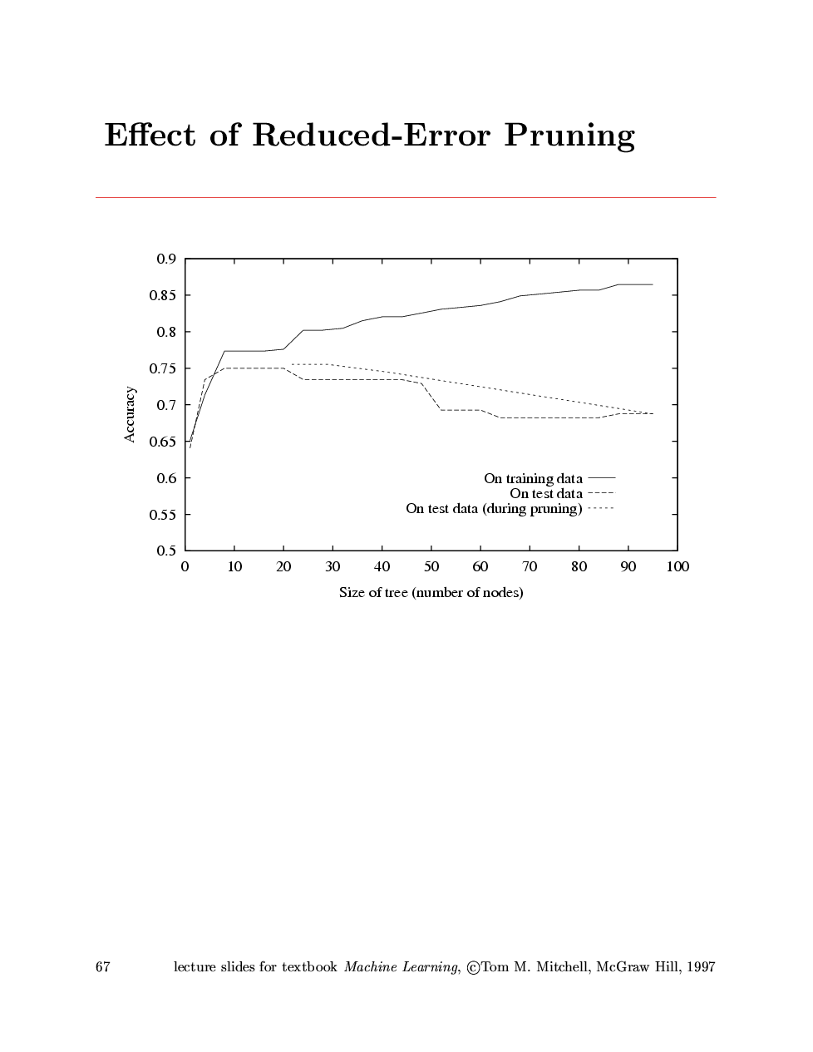
Effect of Reduced Error Pruning

Slide 8
Model selection
Choosing the degree of the polynomial
finding the best hypothesis as two tasks:
model selection defines the hypothesis space
optimization finds the best hypothesis within that space.

Slide 9
Model selection…..contd
How to select among models that are parameterized by size?
size = 1 for linear functions
size = 2 for quadratics, and so on.
For decision trees, the size could be the number of nodes in the tree
size parameter that best balances underfitting and overfitting

Slide 10
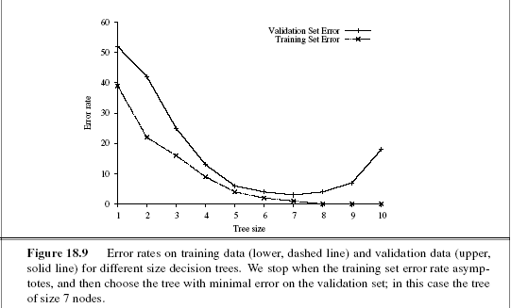
Model selection…..contd

Slide 11
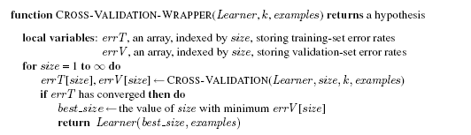
Model selection…..contd

Slide 12
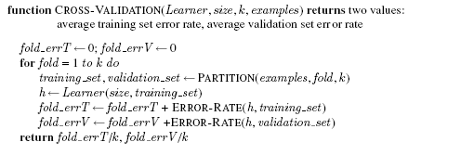
Model selection…..contd

Slide 13
From error rates to loss
classifying email messages as spam or non-spam
Case1: spam as non-spam
Incorrect classification
But still better
Case2: non-spam as spam
Incorrect classification
worst

Slide 14
From error rates to loss
Which classifier will be better??
classifying spam as non-spam with 1% error rate
OR
classifying non-spam as spam with 0.5% error rate

Slide 15
From error rates to loss
The loss function L(x, y, yˆ) is defined as the amount of utility lost by predicting h(x)=yˆ when the correct answer is f(x) = y:
L(x, y, yˆ) = Utility(result of using y given an input x) − Utility(result of using yˆ given an input x)

Slide 16

From error rates to loss
Simplified form : L(y, yˆ)
L(spam, nospam)=1
L(nospam, spam) = 10
L(y, y) is always zero

Slide 17


Generalization loss
for a hypothesis h

Slide 18


Empirical loss
On a set of examples, E
IF P(x, y) is not known

Slide 19
Traditional methods of ML
Small-scale learning
where the number of training examples ranged from dozens to the low thousands.
Large scale learning
millions of examples

Slide 20

Regularization
to search for a hypothesis that directly minimizes the weighted sum of empirical loss and the complexity of the hypothesis
λ is a conversion rate
It’s a process of explicitly penalizing complex hypotheses is called regularization.

Slide 21
Feature selection
can be performed to discard attributes that appear to be irrelevant.
Eg. Decision tree prunning

Slide 22
Theory of Learning
Any hypothesis that is seriously wrong will almost certainly be “found out” with high probability after a small number of examples, because it will make an incorrect prediction.
Thus, any hypothesis that is consistent with a sufficiently large set of training examples is unlikely to be seriously wrong:
that is, it must be probably approximately correct(PAC).

Slide 23
PAC learning algorithm
An algorithm that returns hypotheses that are probably approximately correct

Slide 24
A hypothesis h is called approximately correct if error(h) ≤ , where is a small constant.

Slide 25
Hypothesis Space
Hbad
f
- -ball

Slide 26
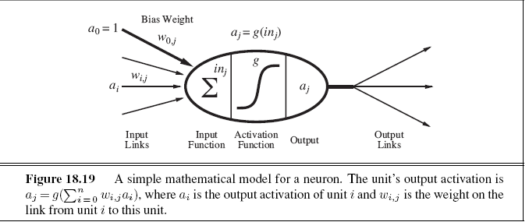
Neural Networks

Slide 27
Neural Networks
Neural networks are composed of nodes or units connected by directed links
A link from unit i to unit j serves to propagate the activation a_{i} from i to j
Each link also has a numeric weight w_{i,j} associated with it
Each unit has a dummy input a0 = 1 with an associated weight w_{0,j}

Slide 28


Neural Networks
Each unit j first computes a weighted sum of its inputs
Then it applies an activation function g to this sum to derive the output:

Slide 29
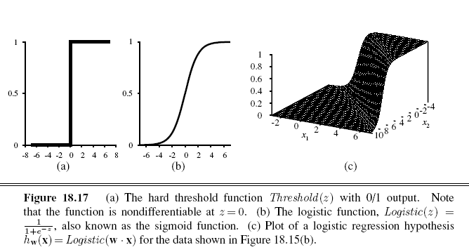
Neural Networks
The activation function g is typically either
a hard threshold
a perceptron
a logistic function
sigmoid perceptron
It is differentiable

Slide 30
feed-forward network
has connections only in one direction
arranged in layers
upstream nodes (Input)
downstream nodes (Output)

Slide 31
Recurrent network
feeds its outputs back into its own inputs
depend on previous inputs
can support short-term memory

Slide 32
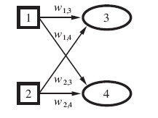
Single-layer feed-forward neural networks (perceptrons)
A network with all the inputs connected directly to the outputs is called a single-layer neural network, or a perceptron network.

Slide 33
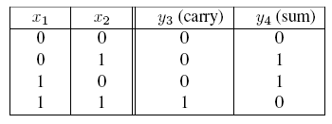
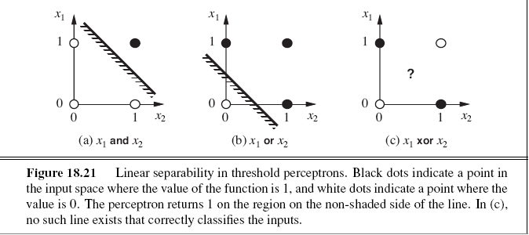
Single-layer feed-forward neural networks (perceptrons)

Slide 34
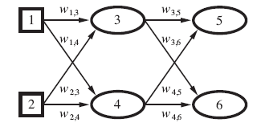

Multilayer feed-forward neural networks

Slide 35

Learning in multilayer networks
A perceptron network decomposes an m-output problem into m separate learning problems.
Whereas the error y − h_{w} at the output layer is clear, the error at the hidden layers seems mysterious
Back Propogation

Slide 36
Back Propogation
j-> Hidden nodes
K-> error at output nodes

Slide 37
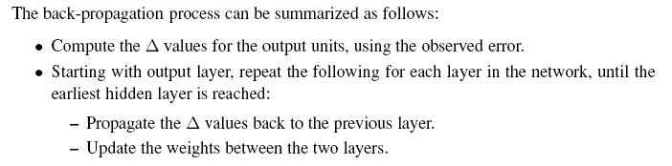
Back Propogation

Slide 38
Non-parametric models
A learning model that summarizes data with a set of parameters of fixed size is called a parametric model.
A nonparametric model is one that cannot be characterized by a bounded set of parameters.
Instance-based learning or memory-based learning
Eg. table lookup
take all the training examples, put them in a lookup table, and then when asked for h(x), see if x is in the table; if it is, return the corresponding y.
It does not generalize well: when x is not in the table all it can do is return some default value.

Slide 39
Nearest neighbor models
table lookup with a slight variation:
given a query x_{q}, find the k examples that are nearest to x_{q}. This is called k-nearest neighbors lookup.
For classification,
plurality vote of the neighbors
Choose k as odd number to avoid tie

Slide 40
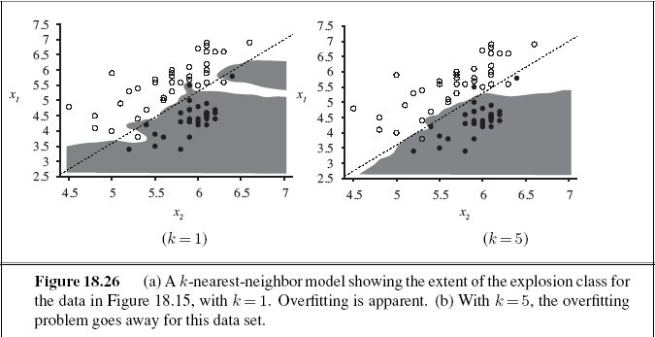
Nearest neighbor models

Slide 41

Nearest neighbor models
distances are measured with a Minkowski distance or L^{p} norm, defined as
With p = 2 this is Euclidean distance
if the dimensions are measuring similar properties, such as the width, height and depth of parts on a conveyor belt
with p = 1 it is Manhattan distance
if the dimensions are measuring dissimilar properties, such as age, weight, and gender of a patient

Slide 42
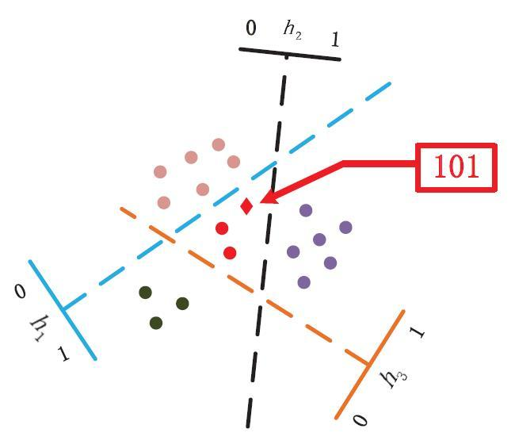
Locality-sensitive hashing

Slide 43
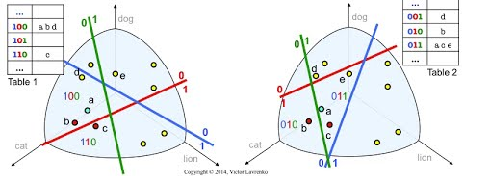
Locality-sensitive hashing

Slide 44
Will Regression help?

Slide 45
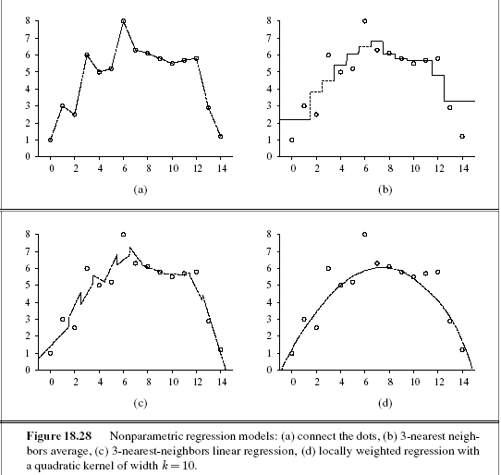

Slide 46
locally weighted regression
At each query point xq, the examples that are close to xq are weighted heavily, and the examples that are farther away are weighted less heavily or not at all.
The decrease in weight over distance is always gradual, not sudden.
Kernel: how much to weight each example

Slide 47
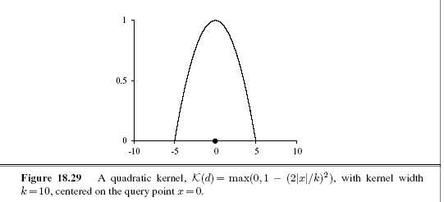
locally weighted regression

Slide 48
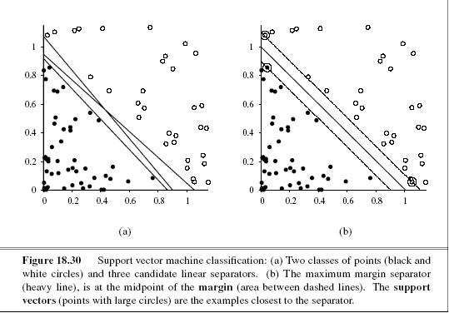
Support Vector Machine

Slide 49
SVM
SVMs construct a maximum margin separator
SVMs create a linear separating hyperplane, but they have the ability to embed the data into a higher-dimensional space, using the so-called kernel trick. Often, data that are not linearly separable in the original input space are easily separable in the higher dimensional space.
SVMs combine the advantages of nonparametric and parametric models

Slide 50
Online Learning
if the future bears no resemblance to the past, then how can we predict anything?
when the data are not i.i.d
when data can change over time
An agent receives an input x_{j} from nature, predicts the corresponding y_{j} , and then is told the correct answer.
Then the process repeats with x_{j+1}, and so on

Slide 51
Online Learning
Let us consider the situation where our input consists of predictions from a panel of experts.
For example, each day a set of K pundits predicts whether the stock market will go up or down, and our task is to pool those predictions and make our own.

Slide 52
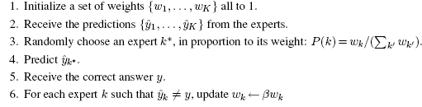
Online learning
Keep track of how well each expert performs, and choose to believe them in proportion to their past performance. This is called the randomized weighted majority algorithm
B is a penalty parameter

Slide 53
Regression and Classification
Univariate Linear Regression
Multivariate Linear Regression

Slide 54
Univariate Linear Regression
y = w₁x+ w₀,
where w₀ and w₁ are real-valued coefficients to be learned.
The task of finding the hw that best fits these data is called linear regression

Slide 55
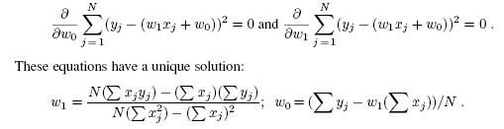
Univariate Linear Regression
We would like to find,
After minimizing to partial derivatives,

Slide 56
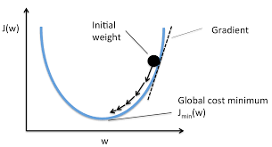
Univariate Linear Regression

Slide 57
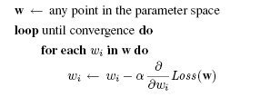
Univariate Linear Regression
α, which we called the step size or learning rate

Slide 58
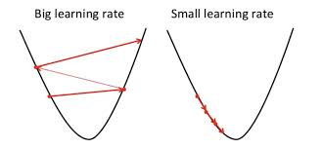
Univariate Linear Regression

Slide 59
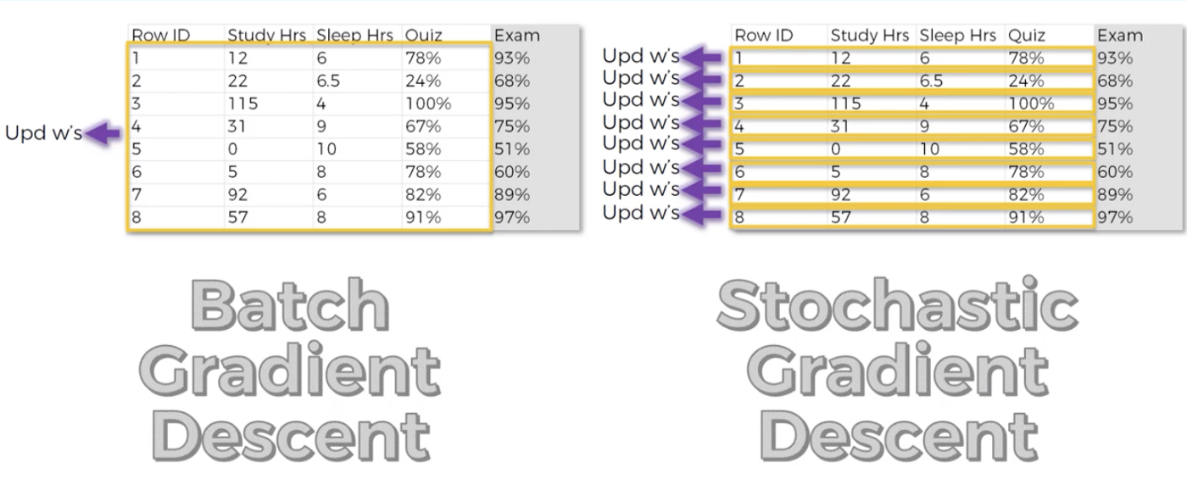
Univariate Linear Regression

Slide 60
Univariate Linear Regression
batch gradient descent:
Convergence to the unique global minimum is guaranteed
May be very slow
stochastic gradient descent:
where we consider only a single training point at a time
can be used in an online setting
often faster than batch gradient descent.
it does not guarantee convergence

Slide 61
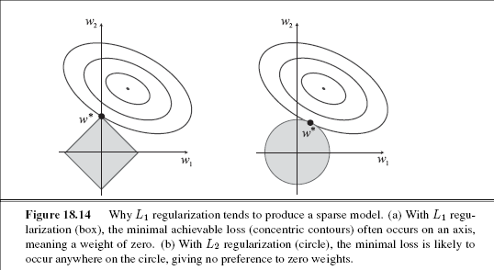
Multivariate Linear Regression

Slide 62
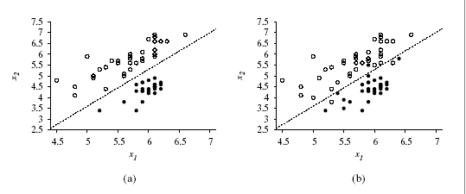
Linear classifiers with a hard threshold

Slide 63
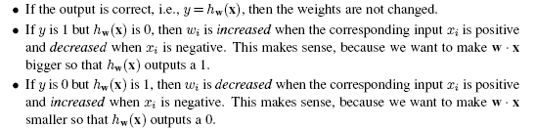
Linear classifiers with a hard threshold
perceptron learning rule:
the true value y and the hypothesis output hw(x) are either 0 or 1, so there are three possibilities:

Slide 64
